Slide 1
DH 307
Oral Health Project
Rehna Afroz Shaik
22B3932

Slide 2
Problem Statement
For detection of various oral pathologies like oral pre-cancerous lesions, caries, gingivitis, etc., it is required to identify various position, type of teeth, lesions etc, and identify any features required for better predictions.
Goal
Fine-tune various state-of-the-art classification models on the given OPMD dataset
Compare and evaluate the different models and identify the best one for identifying the pathology type of the oral cavity image

Slide 3
Literature Review
Paper:
Screening of oral potentially malignant disorders and oral cancer using deep learning models
Karishma Madhusudan Desai1,2, Pragya Singh 2, Mahima Smriti2, VivekTalwar3, Manav Chaudhary2, George Paul2, Subhas Chandra Kolli2, Parisa Sai Raghava2, Golla Vamshi Krishna2, C. V. Jawahar3, P. K.Vinod 4,5, Varma Konala2,6 & Ramanathan Sethuraman6
Published: 23 May 2025

Slide 4
Background & Motivation
  Oral cancer rates remain high in low- and middle-income countries, largely due to late diagnoses
  Oral potentially malignant disorders (OPMDs) often precede cancer but are frequently undetected
  There is a need for automated, easy-to-use, point-of-care screening tools, particularly in resource-limited settings
Objective
  Evaluate AI-driven screening tools for detecting OPMDs and oral cancers using images captured via smartphones
  Investigate deployment in two scenarios: cloud-based web apps and native mobile (on-device) apps
Dataset & Annotation
  Utilized Grace dataset of 518 intraoral images, annotated as "suspicious" or "non-suspicious"
  Standardized protocols were followed for lesion annotation and classification

Slide 5
Models Evaluated
  DenseNet-201: A powerful pre-trained convolutional neural network (~20 million parameters)
  FixCaps: A lightweight capsule network variant (~0.83 million parameters), trained from scratch
Key Results
  DenseNet-201:
    F1 score: 0.875
    AUC (Area Under Curve): 0.97
    Overall accuracy: 88.6%
  FixCaps:
    F1 score: 0.828
    AUC: 0.93
    Accuracy: 83.8%
  DenseNet-201 is ideal for cloud deployment; FixCaps is suitable for on-device, mobile-based screening due to its smaller size

Slide 6
Paper:
Classification of Oral Potentially Malignant Disorders Using Multimodal Feature Integration
Buddhadev Goswami†1 Susmit Neogi†2 Saurabh Nagar3 Nirmal Punjabi1 Ravindra Gudi4

Slide 7
This paper proposed a novel hybrid framework for early detection of Oral Potentially Malignant Disorders (OPMDs)
Methods
Multimodal Feature Integration: This paper proposes a framework that merges standard RGB imaging with hyperspectral imaging (HSI) features. To enrich RGB data without the need for expensive equipment, a Multi-stage Spectral-wise Transformer (MST++) is employed for spectral reconstruction—even when only RGB input is available
Feature Engineering: A diverse set of features is extracted to create a robust representation:
Hu Moments (shape descriptors)
Haar texture features
SIFT descriptors combined with a Bag-of-Visual-Words model
RGB statistical features
Hyperspectral spectral features via MST++
This comprehensive feature fusion helps capture both spatial, textural, and spectral characteristics of lesions

Slide 8
Classification Model: The paper uses an optimized Random Forest classifier. This choice is well-suited for handling high-dimensional, multimodal feature vectors, especially when datasets are limited or imbalanced
Advantages & Context
Data-Efficient & Practical: By reconstructing spectral information from RGB data through MST++, the framework avoids reliance on costly hyperspectral imaging hardware—making it more viable in resource-constrained clinical settings
Adaptable to Limited Datasets: Instead of deep learning models that require large annotated datasets, this approach relies more on handcrafted features and classical ML (Random Forests), which can better handle small or imbalanced datasets typical in medical imaging

Slide 9
Paper:
ResNet
Kaiming He Xiangyu Zhang Shaoqing Ren Jian Sun

Slide 10
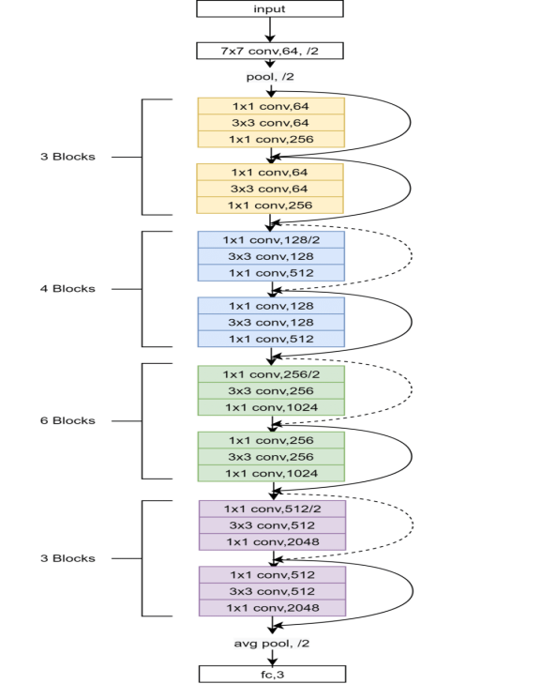
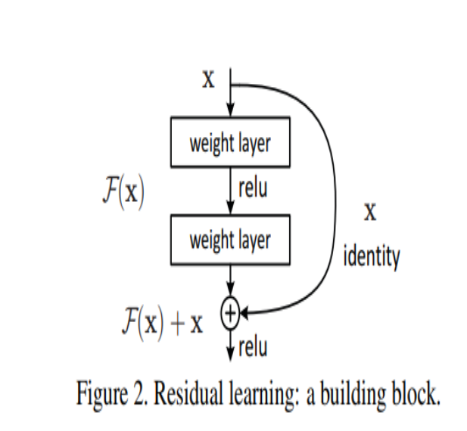
Motivation
  Deeper neural networks usually perform better (more representational power).
  But as depth increases, training becomes difficult:
    Vanishing/exploding gradients → optimization problem.
    Degradation problem → deeper models sometimes have higher training error than shallower ones.
Key Idea
  Then output becomes: y=F(x)+x
  The shortcut (identity connection) allows gradients to flow easily backward, solving vanishing gradient issues.

Slide 11
Paper:
Densely Connected Convolutional Networks
Gao Huang, Zhuang Liu, Laurens van der Maaten, Kilian Q. Weinberger

Slide 12
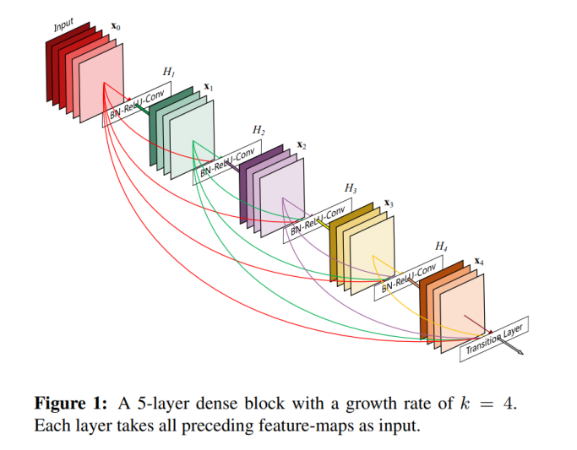
Dense Block: group of densely connected layers.
Transition Layer: reduces feature map size and number of channels (using 1×1 conv + pooling).
Growth Rate (k): number of new feature maps each layer adds. Keeps network compact.
Feature reuse
  Explicit feature reuse: every layer has direct access to all previously learned feature maps.
  Strong gradient flow, richer representations.
  Encourages the network not to relearn redundant features but build upon old ones.

Slide 13
Dataset
Piyarathne et al_2024_Zenodo OPMD & OC dataset
3000 images
Size : 1200 x 1600
Data Available:
  IMAGE_DIR Images (3000 images)
  ANNOTATION_FILE (Annotation.json)
  IMAGEWISE_METADATA_FILE (imagewise_data.xlsx)
  PATIENTWISE_METADATA_FILE (patientwise_data.xlsx)

Slide 14
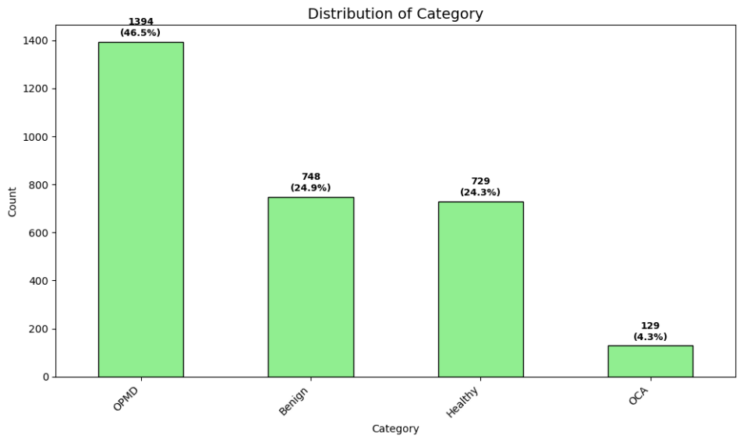
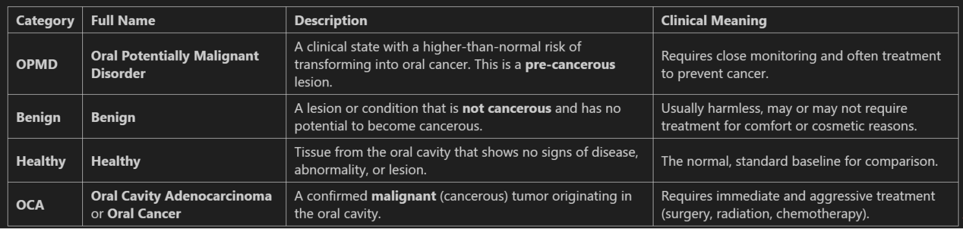
4 categories
    OPMD
    Benign
    Healthy
    OCA

Slide 15
Methodology
Input Image → Preprocessing→ Classifier (DL model)
Preprocessing
  Cropping
  Resizing (224 x 224)
  Data Augmentation:
    Geometric: Horizontal flips, rotations
    Photometric: Color Jitter ( Brightness, Contrast, Saturation, Hue)
Classification models
  ResNet18
  ResNet50
  DenseNet121
  EfficientNet-B0
  EfficientNet-B3
  Vision Transformer(ViT_b_16)
  ConvNeXt-Tiny

Slide 16
Type of classification → Multi-class Classification
→ 3 Classes
    Healthy
    OPMD
    OCA
Count of each Category in the dataset:
      Healthy 729 (46.49 %)
      OPMD 710 (45.28 %)
      OCA 129 (8.227 %)
Dataset is imbalanced (Imbalance Ratio: ~ 6:1)
To address this "Weighted Cross Entropy Loss“ function is used
Early stopping is used to prevent overfitting
Criterion → Weighted Cross Entropy Loss
Optimizer → Adam / AdamW
Scheduler → CosineAnnealingLR

Slide 17
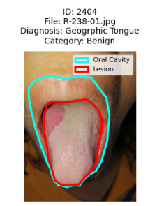
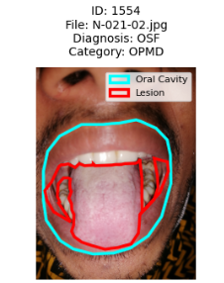
Results
Experiment -1
  Input: Raw Images resized to 224x224
  Data transforms on the train set
    RandomHorizontalFlip(p=0.5),
    RandomRotation(degrees=10),
    ColorJitter(brightness=0.1, contrast=0.1,
    saturation=0.1, hue=0.05),
    ToTensor(),
    Normalize(mean[0.5088, 0.3543, 0.3055],
  std=[0.2845, 0.2283, 0.2253])
  Removed the Benign and OSF images from the image dataset
  Learning Rate = 1e-4
  Criterion → Weighted Cross Entropy Loss
  Optimizer → Adam / AdamW , Scheduler → CosineAnnealingLR

Slide 18
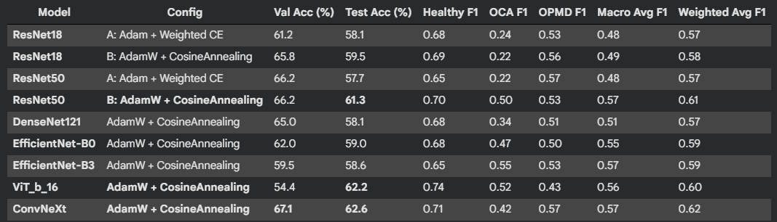

Slide 19
ConvNeXt - AdamW + CosineAnnealingLR
  Test Accuracy: 62.6%
  Highest Validation Accuracy: 67.1% (best generalization)
  Best Weighted F1: 0.62
  Most balanced and reliable performance
2. ViT_b_16 - AdamW + CosineAnnealingLR
  Test Accuracy: 62.2%
  Validation Accuracy: 54.4%
  Best Healthy detection (F1: 0.74)
  Strong overall performance despite lower validation
3. ResNet50 - AdamW + CosineAnnealingLR
  Test Accuracy: 61.3%
  Validation Accuracy: 66.2%
  Good OCA detection (F1: 0.50)
  Consistent performance
Training Configuration Impact
  AdamW + CosineAnnealingLR generally outperforms basic Adam
  ResNet50 shows significant improvement with better optimization (+3.6% accuracy)

Slide 20
Class-Wise Performance Analysis
  Healthy Class:
    Best: ViT_b_16 (F1: 0.74)
    All models: F1 > 0.65
  OCA (Critical Minority Class):
    Best: EfficientNet-B3 (F1: 0.55)
  OPMD Class:
    Best: ResNet50-A & ConvNeXt (F1: 0.57)
    Moderate performance overall
Validation vs Test Consistency
  Most Consistent: ConvNeXt (67.1% val → 62.6% test)
  Overfitting: ViT_b_16 (54.4% val → 62.2% test) - large gap
  Best Generalization: ConvNeXt shows smallest val-test gap

Slide 21
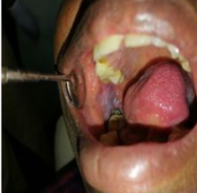
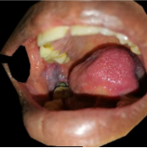
Experiment -2
  Input: Oral cavity parts tight cropped from the Images and then resized to 224x224
  Data transforms on the train set
    RandomHorizontalFlip(p=0.5),
    RandomRotation(degrees=10),
    ColorJitter(brightness=0.1, contrast=0.1, saturation=0.1, hue=0.05),
    ToTensor(),
    Normalize(mean=[0.5091, 0.3415, 0.3140]
std=[0.3110, 0.2445, 0.2411] )
  Learning Rate = 1e-4 / 1e-5
  Criterion → Weighted Cross Entropy Loss
  Optimizer → AdamW
  Scheduler → CosineAnnealingLR
Raw Image just resized to 224x224
Oral cavity cropped from the image and then resized to 224x224

Slide 22
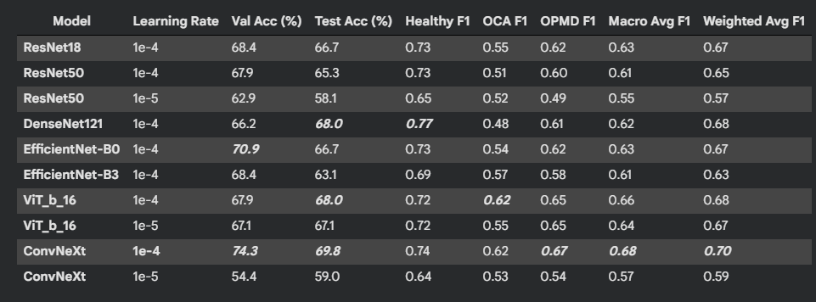

Slide 23
1. ConvNeXt - lr=1e-4
  Test Accuracy: 69.8%
  Highest Validation Accuracy: 74.3%
  Best Overall Balance - strong performance across all metrics
  Good Healthy (F1: 0.74), OPMD (F1: 0.67) and OCA detection(F1: 0.62)
2. ViT_b_16 - lr=1e-4
  Test Accuracy: 68.0%
  Validation Accuracy: 67.9%
  Good OCA detection (F1: 0.62)
  Best generalization
3. DenseNet121 - lr=1e-4
  Test Accuracy: 68.0%
  Validation Accuracy: 66.2%
  Best Healthy detection (F1: 0.77)
4. ResNet18 - lr=1e-4
  Test Accuracy: 66.7%
  Validation Accuracy: 68.4%

Slide 24
Learning Rate Optimization
  Optimal LR: 1e-4 consistently performs best
  ViT_b_16 : 1e-4 (68.0%) > 1e-5 (67.1%) Test Accuracy
  ConvNeXt: 1e-4 (69.8%) > 1e-5 (59.0%)
  ResNet50: 1e-4 (65.3%) > 1e-5 (58.1%)
Class-Wise Performance
  Healthy Class:
    Best: DenseNet121-1e-4 (F1: 0.77)
  OCA (Minority Class):
    Best: ViT_b_16-1e-4 (F1: 0.62) & ConvNeXt-1e-4 (F1: 0.62)
  OPMD Class:
    Best: ConvNeXt-1e-4 (F1: 0.67)

Slide 25
Experiment - 3
  Dataset:
    Piyarathne et al_2024_Zenodo OPMD & OC dataset(3000 Images) + extra OPMD images(874 Images)
  Input: Oral cavity parts tight cropped from the Images and then resized to 224x224
  Data Statistics (Mean, Standard Deviation) is used
  Data transforms on the train set
    RandomHorizontalFlip(p=0.5),
    RandomRotation(degrees=10),
    ToTensor(),
    Normalize(mean=[0.6246, 0.4630, 0.4216],
std=[0.2522, 0.2333, 0.2270])

Slide 26
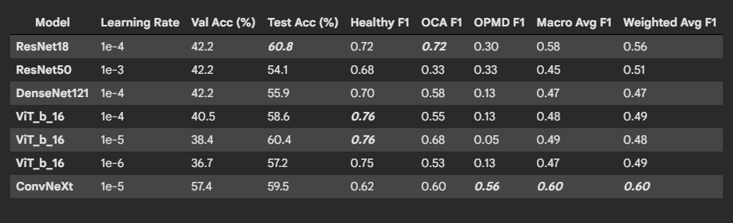

Slide 27
1. ResNet18 - lr=1e-4
  Test Accuracy: 60.8%, Validation Accuracy: 42.2%
  Best OCA detection (0.72 F1) - crucial for minority class
  Good Healthy detection (0.72 F1)
2. ConvNeXt - lr=1e-5
  Test Accuracy: 59.5%, Validation Accuracy: 57.4%
  Best OPMD detection (0.56 F1)
  Highest validation accuracy (57.4%) - best generalization
3. ViT_b_16 - lr=1e-5
  Test Accuracy: 60.4%, Validation Accuracy: 38.4%
  Strong OCA detection (0.68 F1)
  Best Healthy detection (0.76 F1)

Slide 28
Experiment - 4
  Dataset:
    Piyarathne et al_2024_Zenodo OPMD & OC dataset(3000 Images) + extra OPMD images(874 Images)
  Input: Oral cavity parts tight cropped from the Images and then resized to 224x224
  ImageNet Statistics (Mean, Standard Deviation) is used
  Data transforms on the train set
    RandomHorizontalFlip(p=0.5),
    RandomRotation(degrees=10),
    ToTensor(),
    Normalize(mean=imagenet_mean
std=imagenet_std) ])

Slide 29
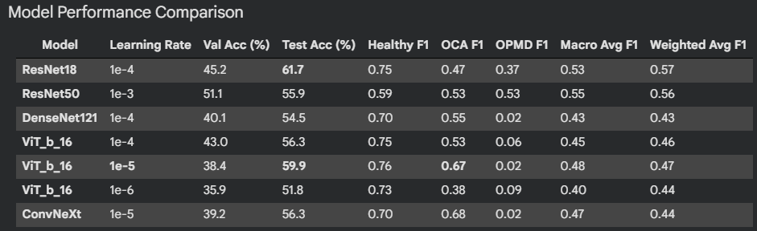

Slide 30
1. ResNet18 - lr=1e-4
  Test Accuracy: 61.7% , Validation Accuracy: 45.2%
  Most Balanced Performance - all classes have reasonable F1 scores
2. ViT_b_16 - lr=1e-5
  Test Accuracy: 59.9%, Validation Accuracy: 38.4%
  Best OCA detection (0.67 F1)
  Best Healthy detection (0.76 F1)
3. ResNet50 - lr=1e-3
  Test Accuracy: 55.9% , Validation Accuracy: 51.1%
  Most consistent across all classes – similar F1 scores across all classes
  Best generalization

Slide 31
Conclusion
Training on the cropped oral cavity parts of the Piyarathne et al_2024_Zenodo OPMD dataset gives the best validation, test accuracy and F1 scores
Best Architecture: ConNeXt ( Learning rate: 1e-4, Optimizer: AdamW, Scheduler: CosineAnnealingLR )

Slide 32
Integrate advanced segmentation models (U-Net, Mask R-CNN) to obtain more accurate and standardized oral cavity crops, reducing noise from imperfect masks
Develop a clinically interpretable pipeline using Grad-CAM++, Score-CAM, and uncertainty maps to visualize lesion regions relevant to OCA/OPMD diagnosis
Optimize for deployment by compressing models (quantization, pruning) and converting to mobile formats for portable oral screening devices.
Future Work

Slide 33
THANK YOU

